Slide 1
Biohacking as possible playground for genome editing
Caroline Pöchlauer
Daniel Derndorfer
18th Annual STS Conference Graz,
6-7 May 2019

Slide 2

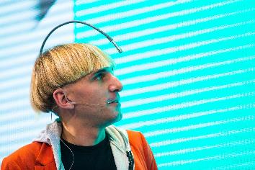


Search Queries for „Biohacking“
nutrition trend
enhancement
citizen science
bioterrorism
Pexels.com
Notes:
Nutrition based trend
Citizen science
Enhancement or „grinding“
Bioterrorism

Slide 3
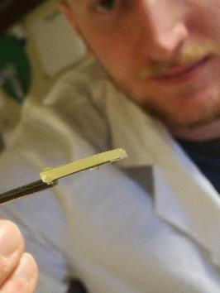
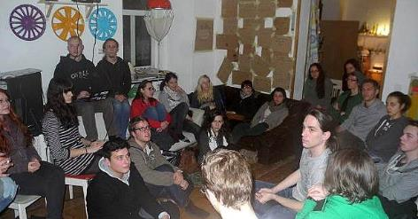
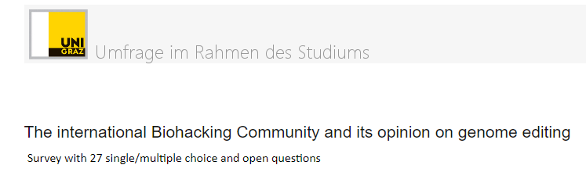
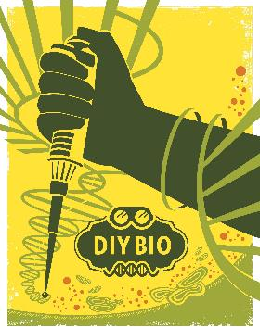
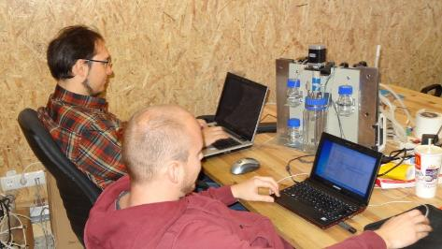
Our Definition of Biohacking
„self motivated participation in life sciences/genetic engineering/research outside of academia/industry“
- publications - online research - personal experience
Realraum
Diybio.org
Notes:
Self interest and curiosity
Actuall doing/Making/Practising science
Do-it-yourself biology (DIYbio)
Hacking

Slide 4
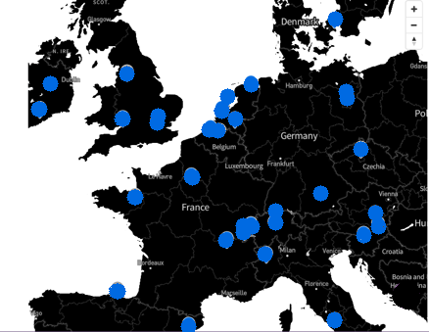
European Biohacker Community
Network / Connections: DIYbio Sphere, Bio Summit 2018/19
~ 40 different Biohacker Groups in Europe
Code of Ethics
Characteristics of european biohackers
Characteristics of hackerspaces
    Average: facilities with more than 20 members
    Active biohackers: 1 – 10 people
    Funding or Private money
sphere.diybio.org
n= 52

Slide 5
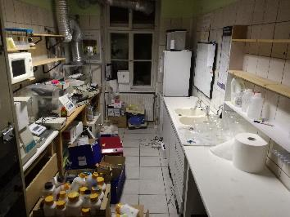
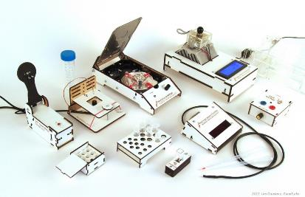
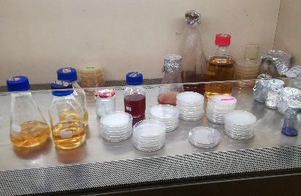
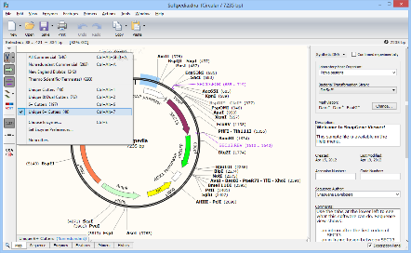
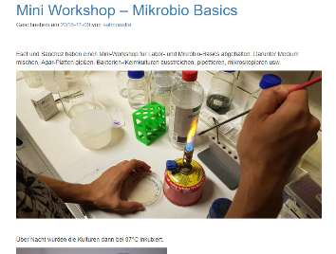
Biohacking activities
Gaudi labs
building up
crafting
wet lab
softpedia.com
bioinformatics
workshops
Realraum
Notes:
Building up a biolab (Foundation)
Crafting the equipment (DIY)
Working wetlab
Hacking with bioinformatics
Providing workshops

Slide 6
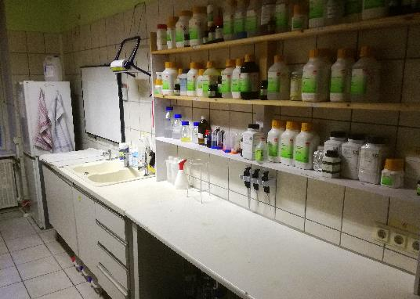
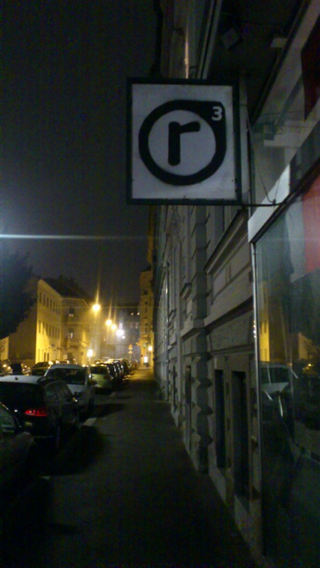
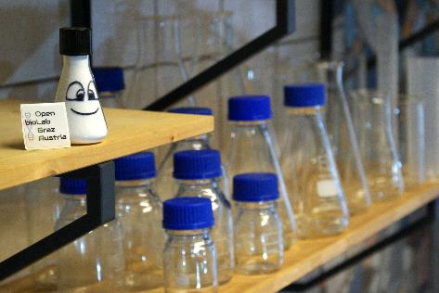
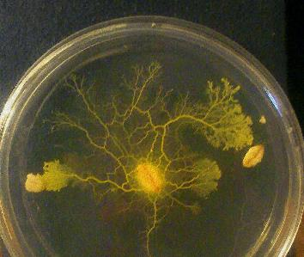
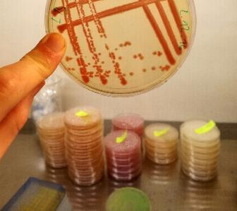
Open bioLab Graz Austria (OLGA)
Realraum

Slide 7

Genome editing
Nature Method of the year 2011
„Biggest game changer to hit biology“ (H .Ledford, Nature)
„Any idiot can do it“ (R. Jaenisch, MIT)
Safe handling and regulation?
https://www.sciencemag.org/news/2016/11/any-idiot-can-do-it-genome-editor-crispr-could-put-mutant-mice-everyones-reach
https://www.nature.com/news/crispr-the-disruptor-1.17673
Notes:
We learned that Biohacking is a young and dynamic movement that is dedicated to the life sciences, especially bio- and gene technology.
One of the most potential and promising technologies in the field of life sciences is genome editing, especially high precision methods like CRISPR/Cas.
Since it was awarded the nature method of the year in 2011, there has been a big hype around it, it is said to be the biggest game changer to hit biology since the invention of the pcr.
Apparently it is so easy and accessible, that according to a MIT scientist any idiot can do it, and it needs fewer time and ressources than former genetic engineering methods.
This has of course also infected biohackers around the globe.
Genome editing is a very promising method for biohacking but also raised concerns that genome editing considerably extends what biohackers can do in their community labs and raised questions of safe handling and regulation of genome editing methods

Slide 8
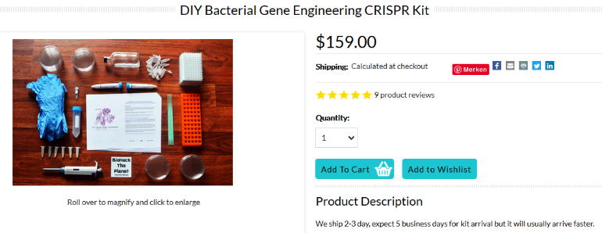
Genome editing in Biohacking
EU: Genome editing equal to genetic engineering -> permitted in safety labs
The Odin – CRISPR Kit - Genome editing for beginners
http://www.the-odin.com/diy-crispr-kit/
Notes:
Biohackers can use genome editing methods depending on the legal regulations.
In the EU Genome editing methods underly the same restrictions as classical genetic engineering, therefore it is permitted in special safety labs and under the condition that the organisms are not released into the environment.
The most practical way for biohackers to get in touch with genome editing is by working with ready to use kits. The American Biohacker Josiah Zayner wants to make GE accessible to everyone and has started a business called The Odin that sells CRISPR Kits. These are designed to perform an experiment where non pathogenic e.coli is edited so that it can grow on a specific medium where it normally can´t.
In Europe working with genome editing is only allowed in special safety labs, so there are special events, like biohacker summits or workshops where biohackers have the opportunity to experiment with this technique. However, in Germany for example the import of the CRISPR Kit is not allowed.
So far, as we know there have not been any big biohacking projects that use genome editing in Europe. To get a better insight into this topic, in our survey we had several questions that focused on the experience with and opinion on genome editing which I will present now.

Slide 9
Biohackers experiences with Genome editing
Cool, hot topic
It is the future
More possibilities
Don´t want to work with it (~20%)
Satz
Bacteria and yeast
Plants
Eukaryotik cell lines
n= 48
Notes:
We found out the majority (60%) of the biohackers who answered our survey have never used genome editing before, however about 30% stated that they have already used it several times.
When we asked about their reasons to experiment with genome editing, we got answers like: it is a cool, hot topic, the future of biology and medicine, many stated that it increases the possibilities of their experiments and about 20% stated, that they don´t want to work with it at all
Also the intentions of biohackers when using GE are quite divers. Biohackers are interested in learning the technique, creating organisms with new features, produce substances (e.g. enzymes) and following bigger goals like curing diseases.
Most of them would use bacteria and yeast organisms for genome editing, also plants and eukaryotic cell lines are interesting for biohackers to be used in genome editing.

Slide 10
Do you expect Genome Editing methods such as CRISPR/Cas to extend biohacking activities ?
Generates enthusiasm and interest
Saves time, resources
New, creative ideas will come up
Similar to genetic engineering – a lot was possible before
Needs more time, knowledge
Notes:
Then we wanted to know about their expectations of the future of genome editing in biohacking.
About two third of the participants agreed, that Genome Editing methods extend biohacking activities.
We got answers, that it was an exciting new technology that generates enthusiasm and interest. Some also pointed out the factor that it saves time and resources compared to other methods. And there was generally great enthusiasm that new creative ideas will come up thanks to genome editing.
However, there were also some voices that said, genome editing was quite similar to genetic engineering and that it did not extend the possibilities that much.
And some also stated that more time, knowledge and regulation is needed for the use of genome editing in biohacking.

Slide 11
Do you expect Genome Editing methods if used in biohacking, to result in increased risks compared to classical genetic modification technology?
Not if done correctly, by educated people
It requires enough learning and dedication to filter out jerks
Discussion can increase awareness
Specific targets for gene drives
More people = bigger risk
Caution and responsibility are needed
Notes:
Then we wanted to know their opinion if this would result in increased risk
Here, we got more nuanced answers.
Many stated that they think it would not lead to increased risk, if it is done correctly, by educated people
The extensive learning process and needed dedication for successful genome editing would prevent misuse
And there was a statement that the accompanied discussion could increase awareness and security
However some biohackers also feared the possibility of making specific targets for gene drives
And there was the argument that more people having access would increase the possibility that something will go wrong
Again many participants pointed out the caution and responsibility needed for experimenting with genome editing.

Slide 12
Biohackers opinions on genome editing
It has to be regulated
Only if done correctly and supervised
Good education is needed
Caution, responsibility, accountability is necessary
n= 38
Notes:
Finally, we asked the survey participants if they would welcome the idea of more people having access to genome editing.
The large majority stated yes, there was only one participant that would not welcome the idea.
Again, there were comments, that genome editing has to be regulated, that supervision and good education is needed as well as caution, responsibility and accountability.

Slide 13
Conclusion
Big interest in new technologies
Awareness of responsibility
No big genome editing biohacking projects until now
Genome editing adds possibilities, but does not radically change biohacking
Does genome editing (method development, safety, discussion)
profit from a broader spectrum of users as in biohacking?
Thank you
Notes:
Our survey is still ongoing, however we can draw some conclusions from it:
In the biohacking community is a big interest in the genome editing technology. Many biohackers already have made experiences with genome editing methods, and some are not at all interested in using it.
There is also the awareness of responsibility for biohacking projects which is demonstrated in the code of ethics and the willingness to discuss potentials and risks of biohacking. However, this is not specific for genome editing but for the whole spectrum of biohacking activities.
GE is a very promising technology for biohackers as it adds possibilities, however it does not radically change the biohacking movement as there are other possibilities for interesting experiments.
In the broad spectrum of biological techniques that biohackers can use, genome editing is rather a next step that helps biohackers to realize their projects than a game changing revolution.

